Slide 1



C19-4-Africa Dashboard
View in Power BI
Last data refresh:
4/10/2020 10:19:36 AM UTC
Downloaded at:
4/10/2020 10:21:48 AM UTC

Slide 2
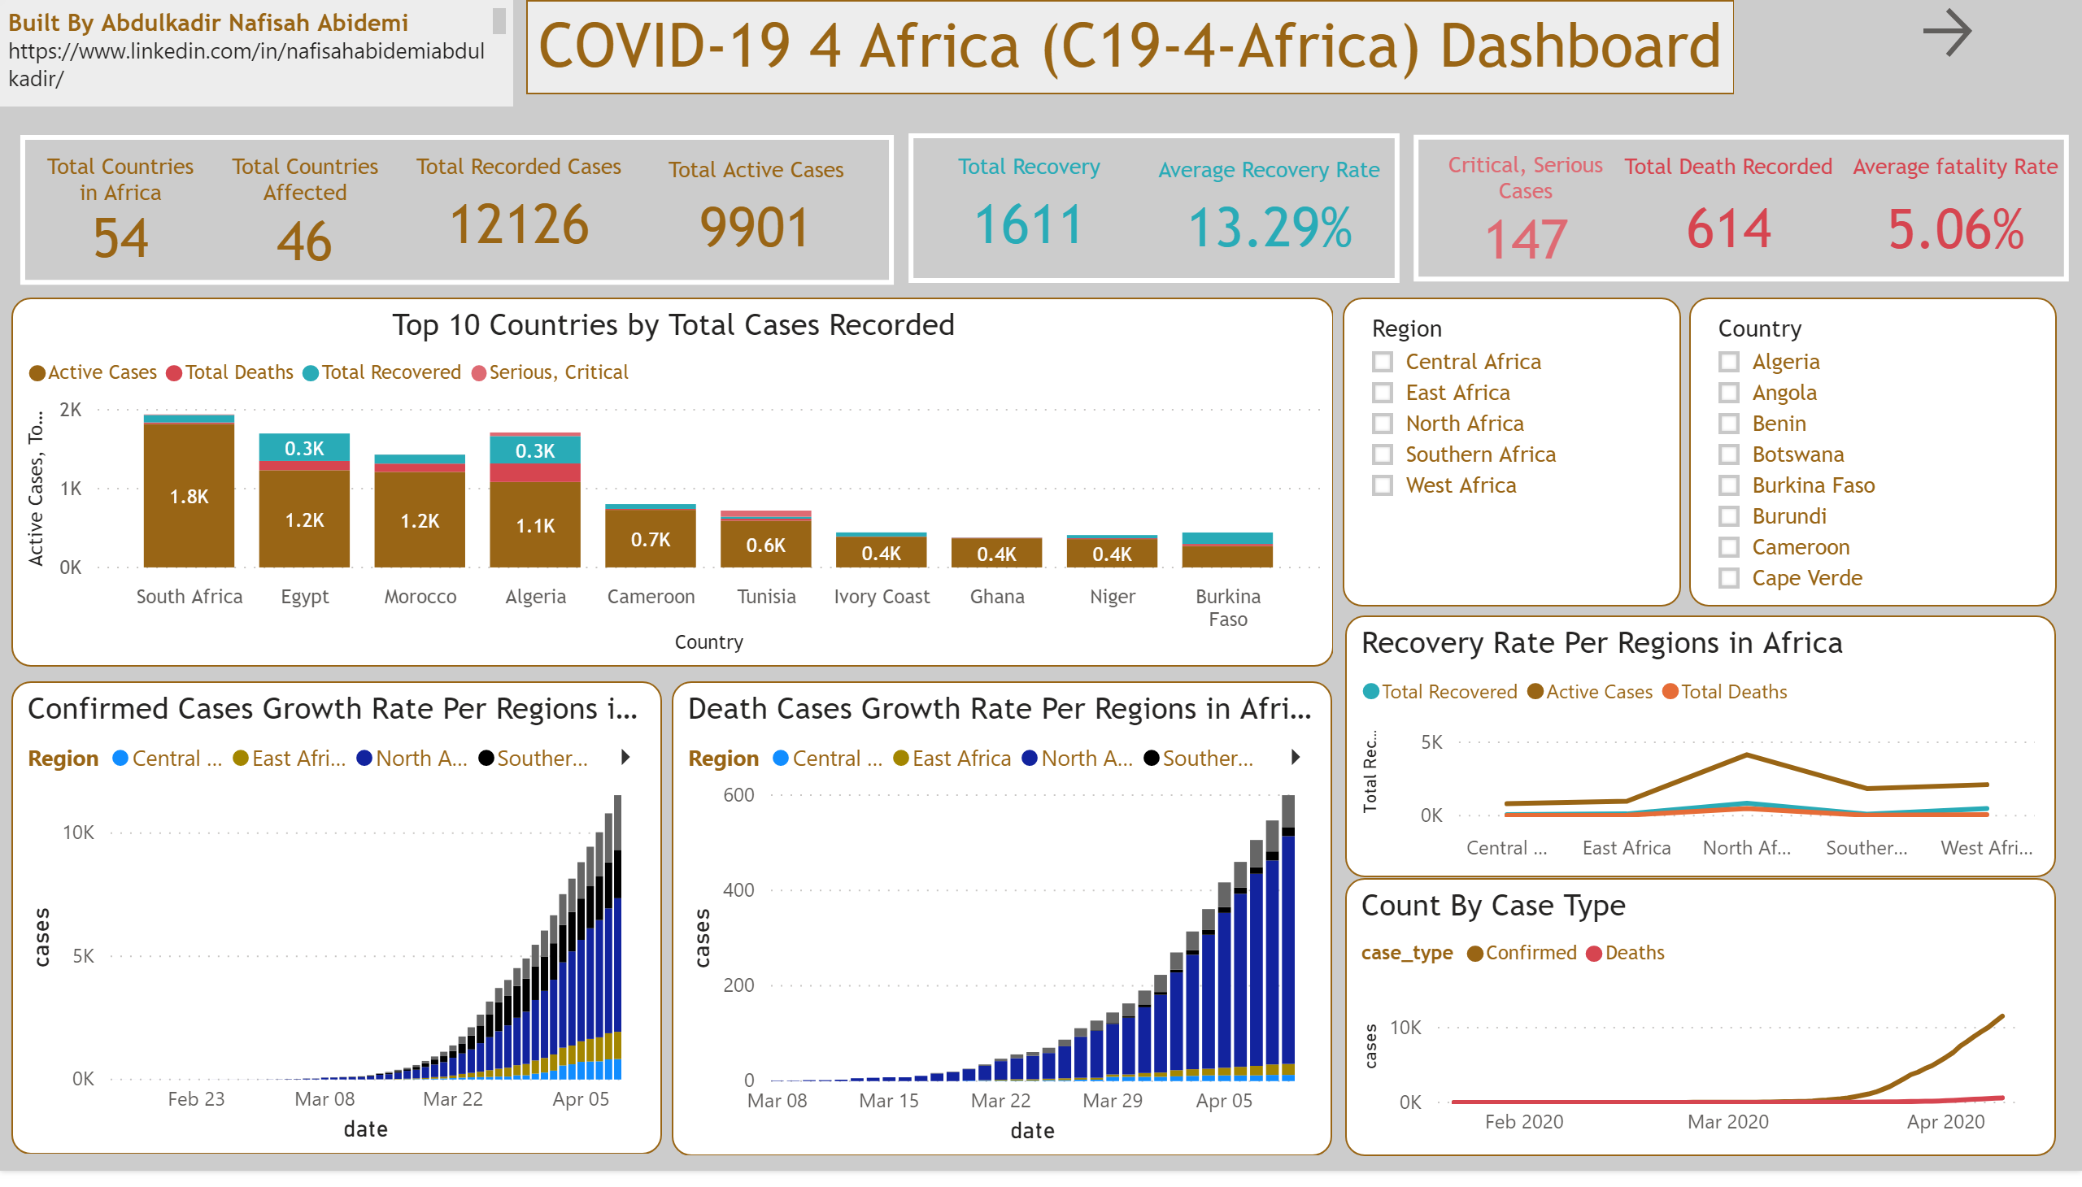

Slide 3
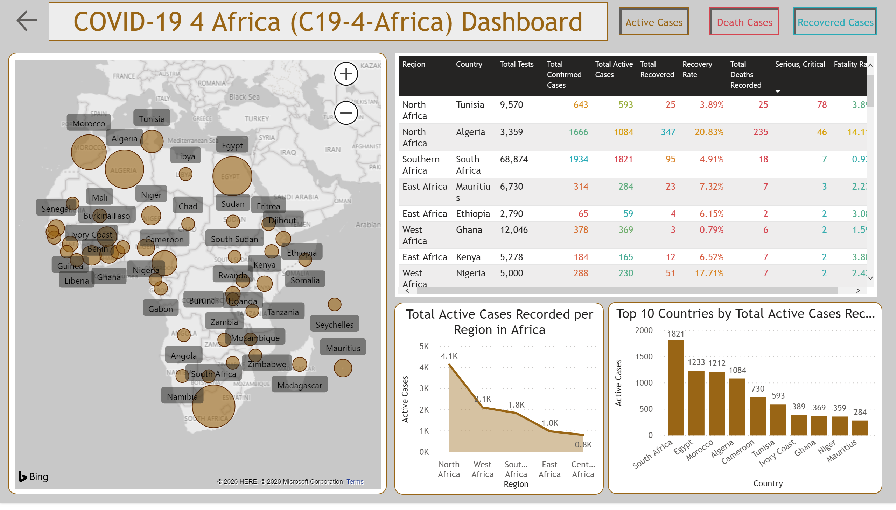

Slide 4
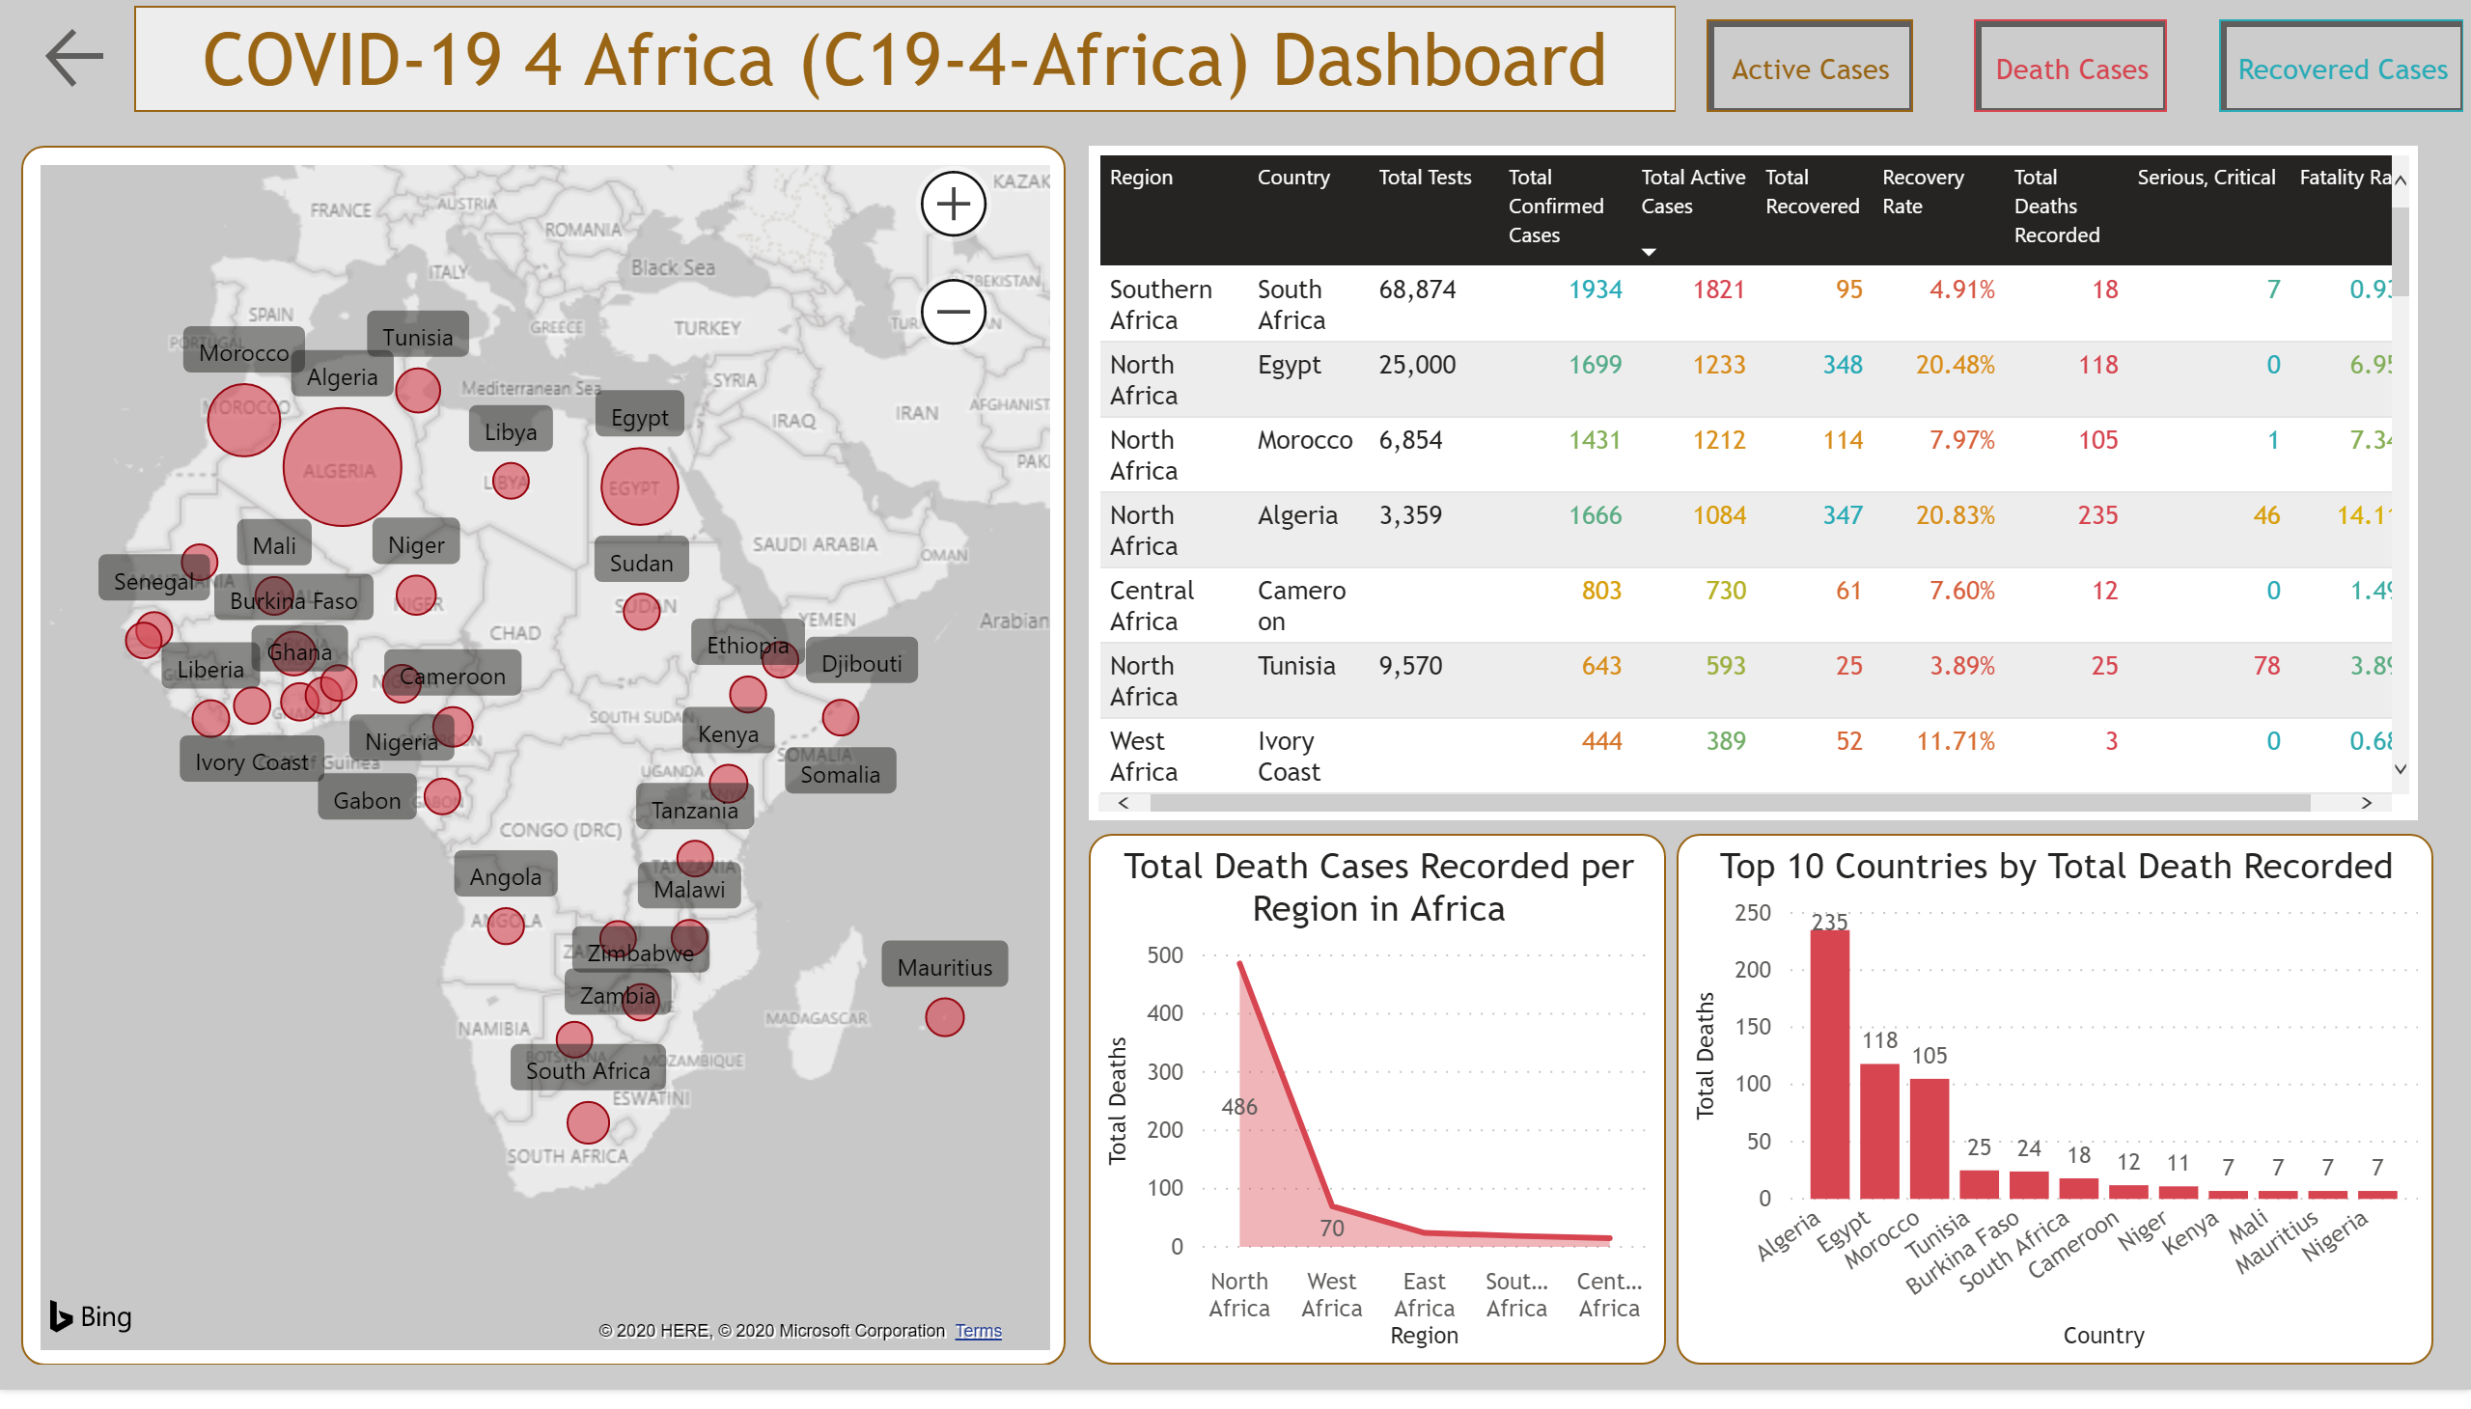

Slide 5
